Slide 1
MESSAGE QUEUING TELEMETRY TRANSPORT
-LIGHT WEIGHT PROTOCOL
by
sheran evangelin

Slide 2
CONTENTS
1
WHAT IS MQTT PROTOCOL
2
WHY WE REQUIRE MQTT
3
HOW MQTT WORKS
4
MQTT HANDSHAKE & QOS
5
SECURITY & RELIABILITY
6
WHERE WE USE MQTT

Slide 3
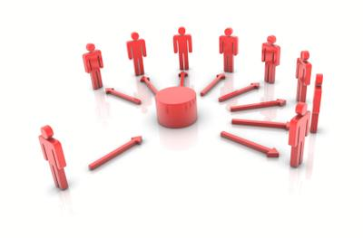
WHAT IS MQTT PROTOCOL
01
MQTT is a lightweight open messaging protocol that provides resource-constrained network clients with a simple way to distribute telemetry information in low-bandwidth environments.

Slide 4
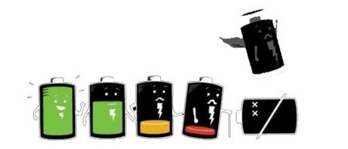
02
WHY WE REQUIRE MQTT PROTOCOL
Every IOT device are POWER HUNGRY. So we can’t use the device longer & it is not possible to feed everytime.To overcome this we require MQTT light weight protocol.
It provides efficient communication, intel gathering, synchronizing sensors.

Slide 5
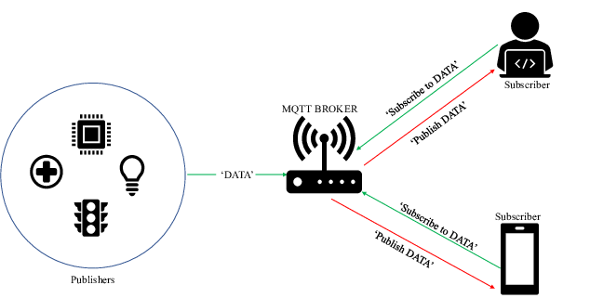
HOW MQTTWORKS
03
It is a Pub-Sub protocol for device communication based on Transmission Control Protocol (TCP) through a broker. In this protocol, a Publisher publishes message under a topic name. Subsequently, all the subscribers under the topic name receives the message through a broker. Various message types are used in this protocol and are distinguished by message type in MQTT message header.

Slide 6
working
04
PUBLISER:- Device which sends data/message (sensor) to broker.
SUBSCRIBER:-Device which receives data/message (sensor) from broker
BROKER:-It organize which subscriber should receive messages.
TOPIC:- This act as a carrier, which carries a data/message to be publish/subscribe.
Publisher will send the data as a payload to a particular topic to the broker. Broker will check for the subscriber who are subscribed to that particular topic and send the data to those subscriber.
The broker doesn’t need to check the payload for the message to deliver it to; it just need to check the topic for each message that has arrived and needs to filter before publishing it to the corresponding subscribers.
Subscriber can subscriber to more than one topic. The broker has to make sure that the subscriber receives the messages that belong to all topics to which it has subscribed.

Slide 7


MQTT HANDSHAKE & QOS
05
In order to establish a connection the MQTT client must send a CONNECT control packet to MQTT broker with a payload that must include all necessary information to initiate the connection and proceed with authentication and authorization. The MQTT broker will check the CONNECT packet, perform authentication and authorization and send a response to client with CONNACK control packet that will analyze in detail after understanding the CONNECT control packet. In case the MQTT client sends an invalid CONNECT control packets,the server will automatically close the connection.

Slide 8
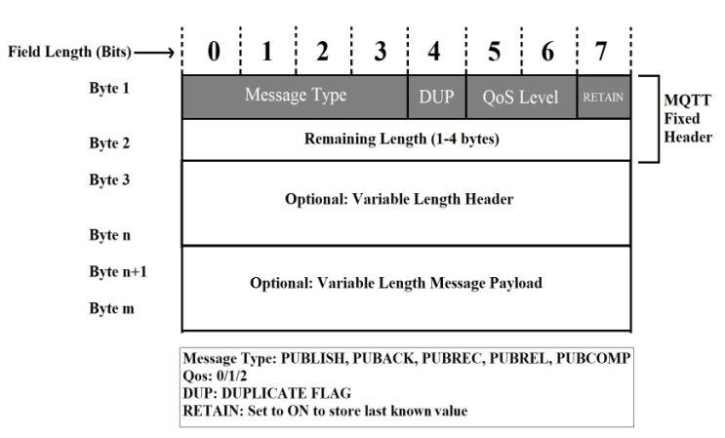
PACKET FORMAT
Possible Packet formats are:
Fixed Header (Control field + Length) – Example CONNACK
Fixed Header (Control field + Length) + Variable Header -Example PUBACK
Fixed Header (Control field + Length) + Variable Header + payload -Example CONNECT
message type will provide 14 combination fo headers

Slide 9
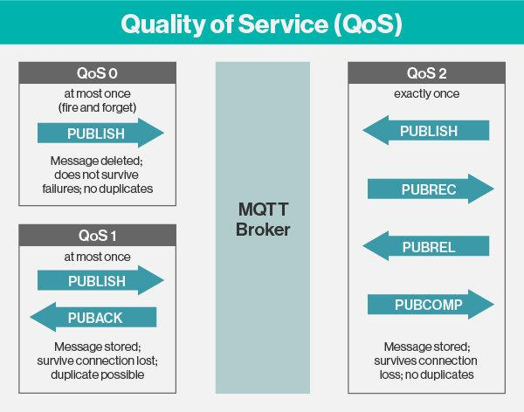
QoS
There are 3 levels to note.
QoS 0: at most once
QoS 1: at least once
QoS 2: exactly once
QoS | Publisher | Subscriber
0: at most once | Will send a message only once. | Might receive or might not receive the message.
1: at least once | Will send a message at least once as long as an acknowledgement is received or the command to end the transmission is received. | It is likely to receive the message at least once (it is possible that the message can be received more than once).
2: exactly once | Will only send a message once. | Will only receive the message once.

Slide 10
SECURITY AND RELIABILITY
Security in MQTT is usually divided into several layers to prevent different types of attacks. Example transport layer is provided by SSL/TLS & application layer provides a client id, client identifier and username/password credentials to authenticate devices on the application level. These properties are provided by the protocol itself. It is important to note that the security mechanisms are initiated by the broker & its up-to the client to comply with it.
Default port number is 1883. Which is not secure & not reliable.
secure port number is 8883 which use TLS. This will act as an bundle over our data.
ISO/OSI LAYER 5-7 | MQTT
ISO/OSI LAYER 4 | TCP
ISO/OSI LAYER 3 | IP

Slide 11
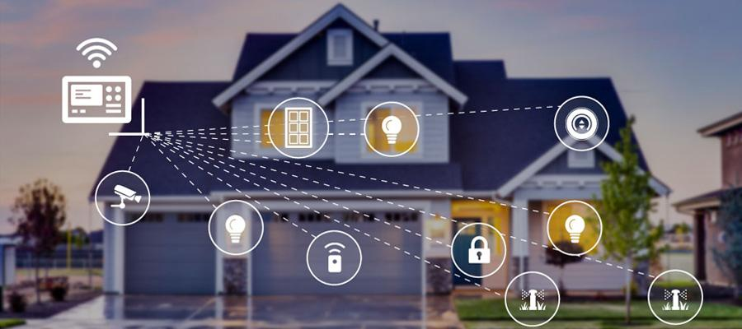
WHERE WE USE MQTT
06
MQTT is used for communication between many consumer IoT devices.
Medical IoT application
Connected vechicles
Smart home appliances
Mobile application
Agriculture fields

Slide 12
THANKS

